Slide 1
Lots of Ocean data here:
http://oos.soest.hawaii.edu/thredds/catalog.html

Slide 2
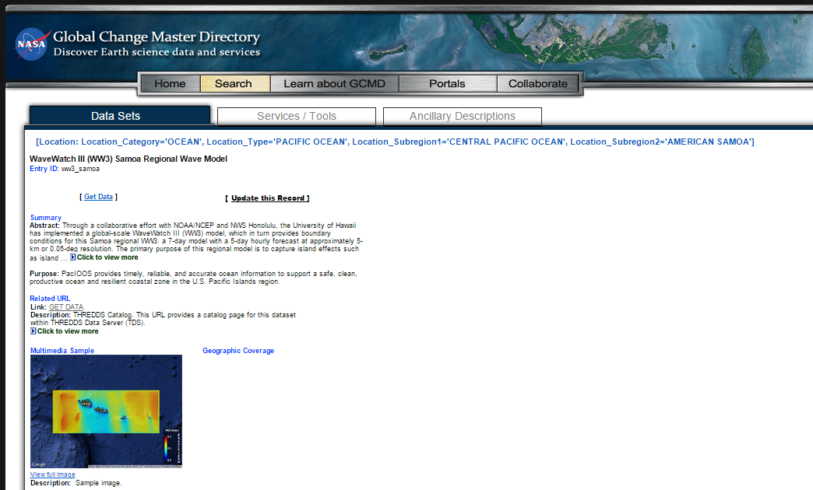
Data from the Wave Watch III Samoa Regional Model at: this link
Summary
Abstract: Through a collaborative effort with NOAA/NCEP and NWS Honolulu, the University of Hawaii has implemented a global-scale WaveWatch III (WW3) model, which in turn provides boundary conditions for this Samoa regional WW3: a 7-day model with a 5-day hourly forecast at approximately 5-km or 0.05-deg resolution. The primary purpose of this regional model is to capture island effects such as island shadowing, refraction, and accurate modeling of local wind waves. The Samoa regional WW3 also provides boundary conditions for nearshore island-scale models via Simulating WAves Nearshore (SWAN). While considerable effort has been made to implement all model components in a thorough, correct, and accurate manner, numerous sources of error are possible. As such, please use these data with the caution appropriate for any ocean related activity

Slide 3
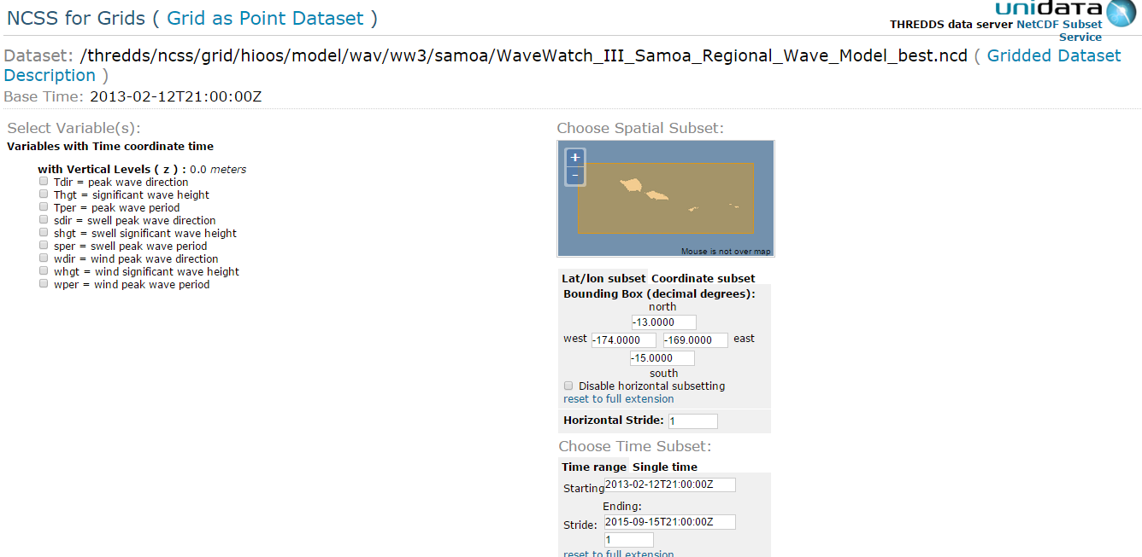
Can download gridded netCDF and extract grid value
“Grids”
or
Can download point data (.csv) for a given lat/lon point
“Grid as Point Dataset”
(careful: data is in degrees east longitude but data query uses degrees west longitude)
Download here: link to oos.soest.Hawaii.edu/thredds…

Slide 4
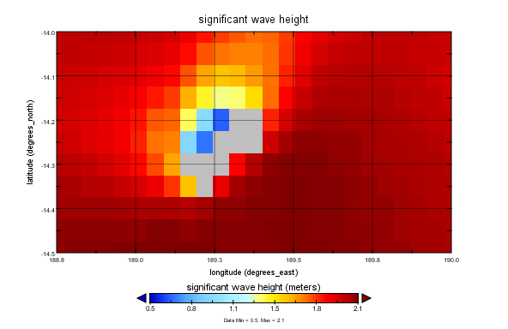
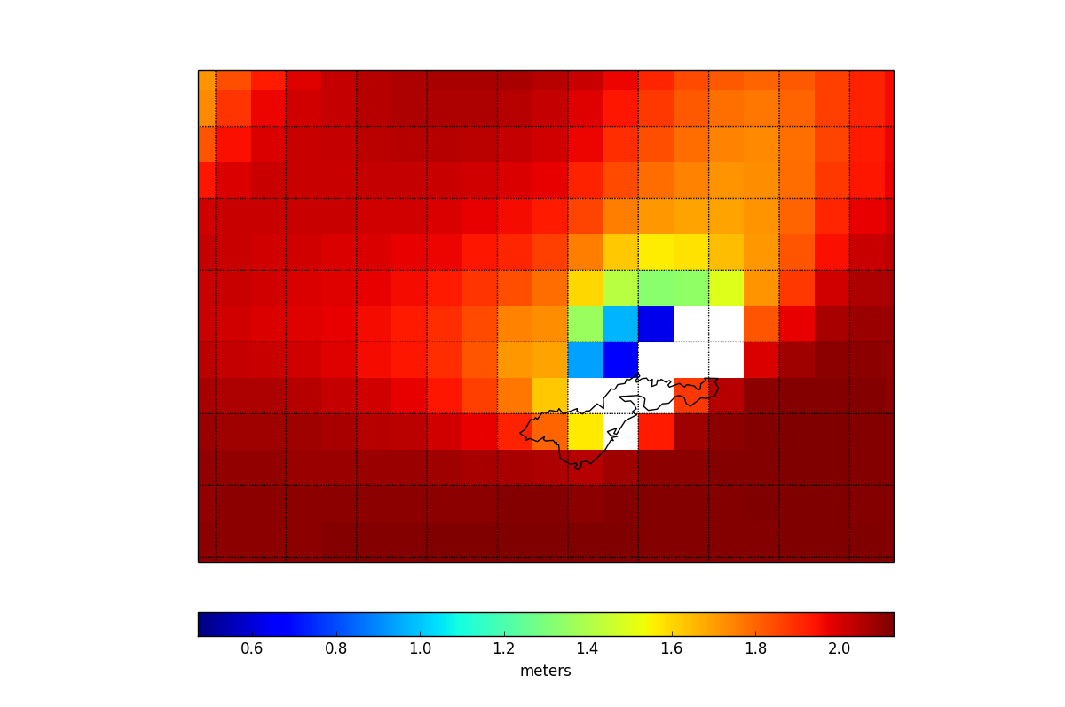
Viewed in NASA panoply
(http://www.giss.nasa.gov/tools/panoply//)
Viewed in Python Basemap
http://matplotlib.org/basemap/
Data value for Faga’alu Bay
-14.30 degrees North
189.35 degrees East (= -170.65 West longitude)

Slide 5
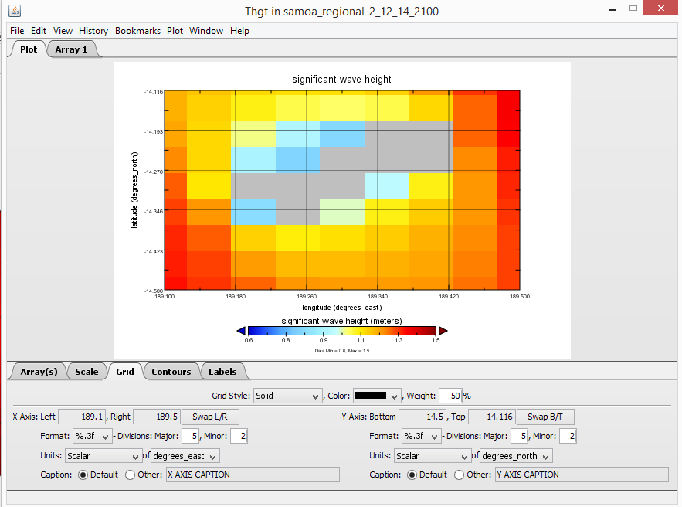
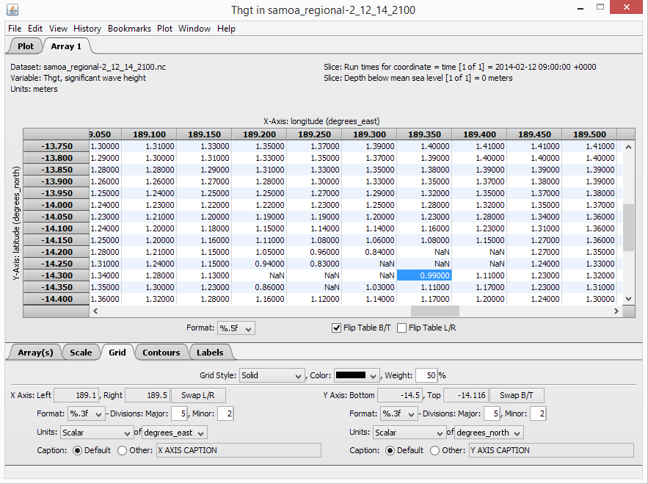

Slide 6
Significant wave height:
Dataset parameters:
Tdir = peak wave direction Thgt = significant wave height = defined traditionally as the mean wave height (trough to crest) of the highest third of the waves (H_{1/3}) Tper = peak wave period sdir = swell peak wave direction shgt = swell significant wave height sper = swell peak wave period wdir = wind peak wave direction whgt = wind significant wave height wper = wind peak wave period

Slide 7
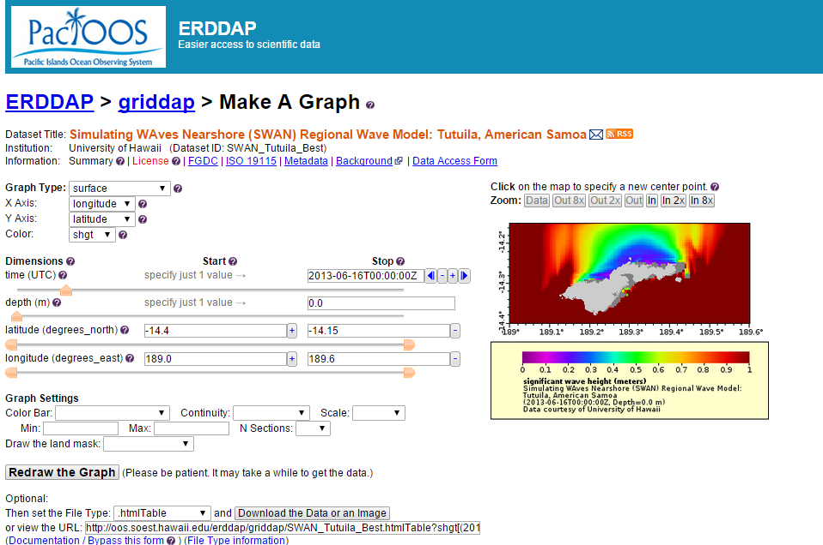
Higher spatial resolution SWAN model: link here
Tutuila SWAN model
summary: Simulating WAves Nearshore (SWAN) regional wave model 7-day output with a 5-day hourly forecast for the island of Tutuila, American Samoa at approximately 500-m resolution. This high-resolution model is utilized to capture shallow water effects and nearshore coastal dynamics such as refracting, shoaling, and smaller scale shadowing. It is run directly after the Samoa regional WaveWatch III (WW3) wave model has completed. Please note that this nested model setup is in the testing and validation phase. While considerable effort has been made to implement all model components in a thorough, correct, and accurate manner, numerous sources of error are possible. As such, please use these data with the caution appropriate for any ocean related activity.

Slide 8
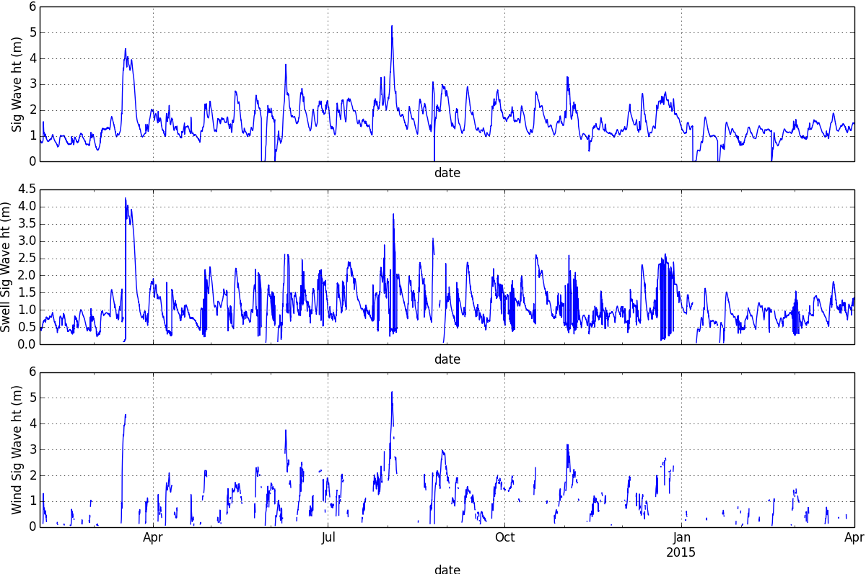

Slide 9
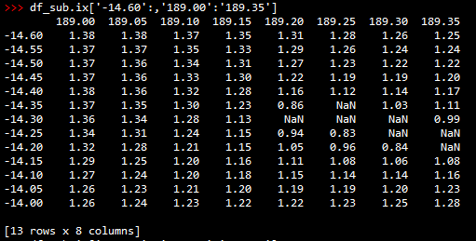
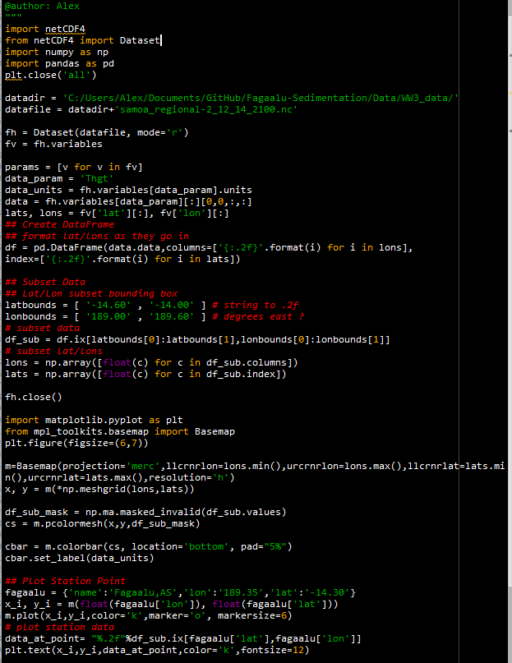
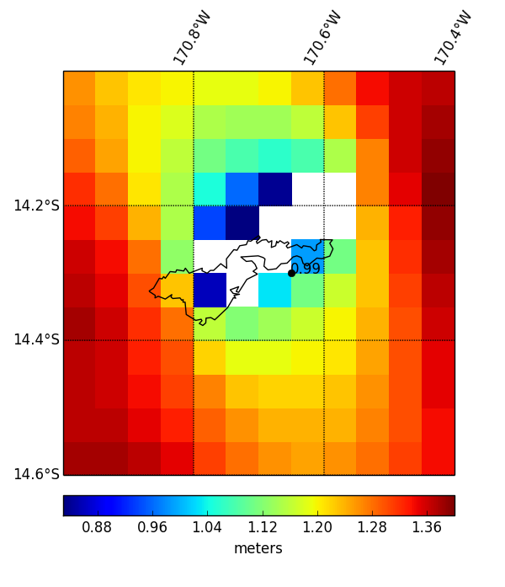
Plotting netCDF4 data in Python
import netCDF4 module
Convert into Pandas DataFrame
Subset by rows(lat)/columns(lon)
Plot masked array
(no mask, no colors)

